Slide 1
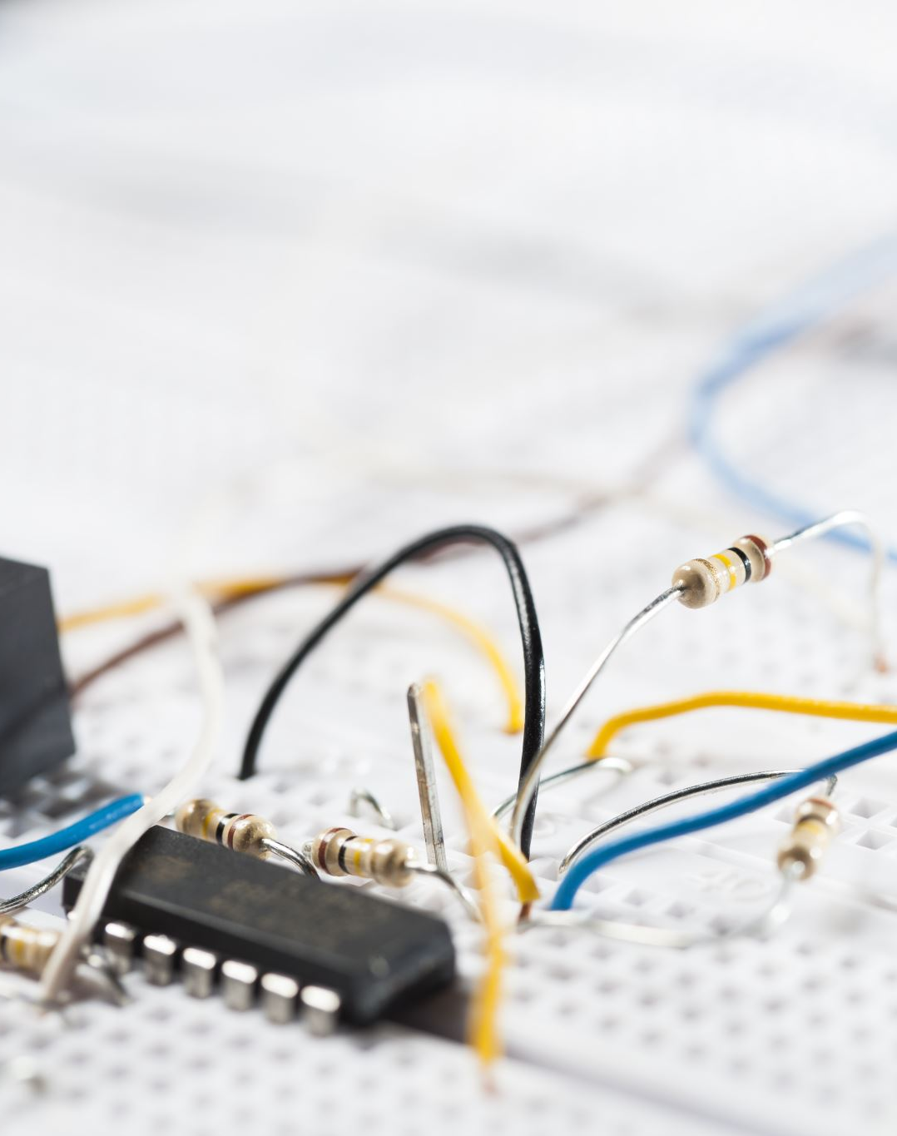
Phase 1, Module 8: Bulletproof Systems
Error Handling & File I/O
Welcome to Module 8. Today we learn how to keep a system alive when the world around it breaks. We will learn how to catch errors before they crash the server, and how to save our data permanently to the hard drive.
Presented By: Zaryab Ahmad

Slide 2
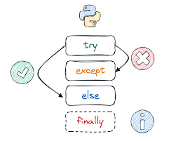
The Reality of Production (Exceptions)
Code Will Fail. Servers Must Not Die.
Syntax Errors: You wrote bad Python (e.g., missed a colon). The system won't even start.
Exceptions: The Python is perfect, but the world broke (e.g., the internet dropped, a file was deleted, a sensor sent text instead of a number).

Slide 3
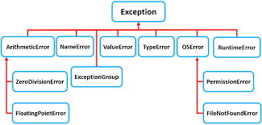

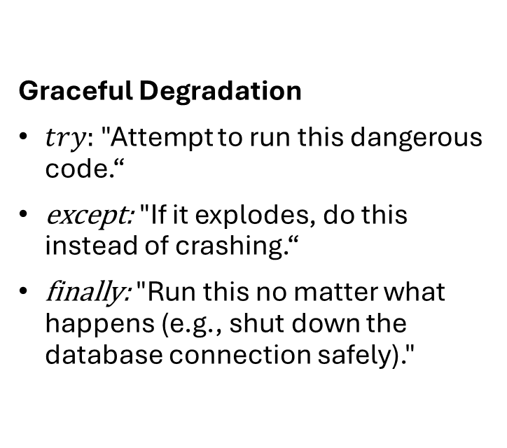
The Shield ($try$, except, finally)
Graceful Degradation
$try:$"Attempt to run this dangerous code.“
except: "If it explodes, do this instead of crashing.“
finally: "Run this no matter what happens (e.g., shut down the database connection safely)."

Slide 4
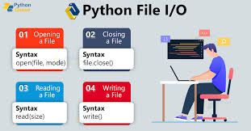
File I/O (Input / Output)
Giving the AI a Hard Drive
Variables live in RAM. When the script ends, the RAM is wiped.
To save data forever, we write to the hard disk (.txt, .csv, .json).
The Danger: Opening a file locks it in the operating system. If you forget to close it, you create a memory leak.

Slide 5
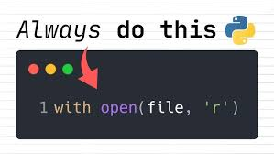

The Context Manager ($with open$)
The Industrial Standard for Files
The with statement creates a "Safe Room.“
The file opens when you enter the room.
The file automatically closes the exact microsecond you leave the room, even if the code crashes inside!

